Slide 1
Model-Based Decomposition
ESTP training

Slide 2
0. Outline
Unobserved component models
STS, AMB
SEATS algorithm
Estimation
MMSE estimators, algorithms
Analysis
Finite / infinite approaches
SEATS in JD+
Parameters, non decomposable models, estimation

Slide 3
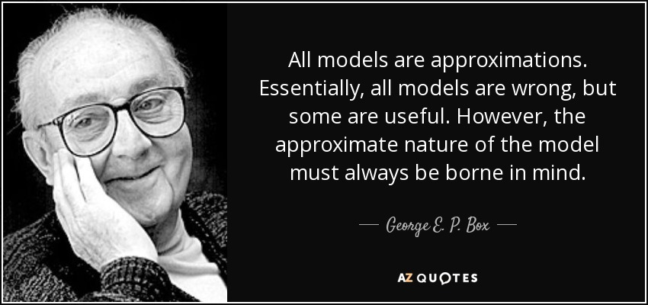
Always keep in mind…

Slide 4
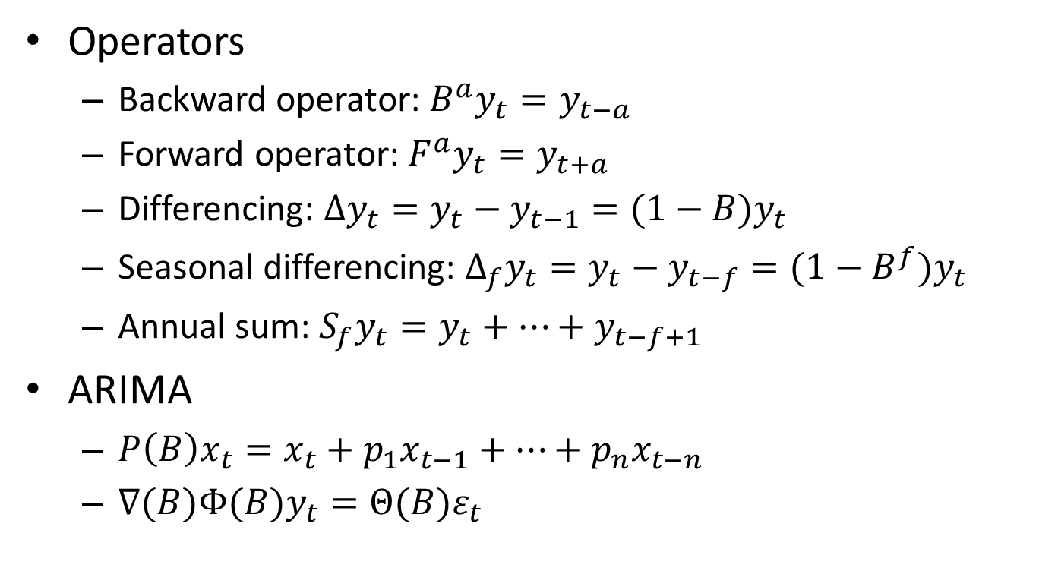
0.1 Some notations
Operators
Backward operator: $B^{a}y_{t}=y_{t−a}$
Forward operator: $F^{a}y_{t}=y_{t+a}$
Differencing: $∆y_{t}=y_{t}−y_{t−1}=(1−B)y_{t}$
Seasonal differencing: $∆_{f}y_{t}=y_{t}−y_{t−f}=(1−B^{f})y_{t}$
Annual sum: $S_{f}y_{t}=y_{t}+⋯+y_{t−f+1}$
ARIMA
$P\left(B\right)x_{t}=x_{t}+p_{1}x_{t−1}+⋯+p_{n}x_{t−n}$
$∇(B)Φ(B)y_{t}=Θ(B)ε_{t}$

Slide 5
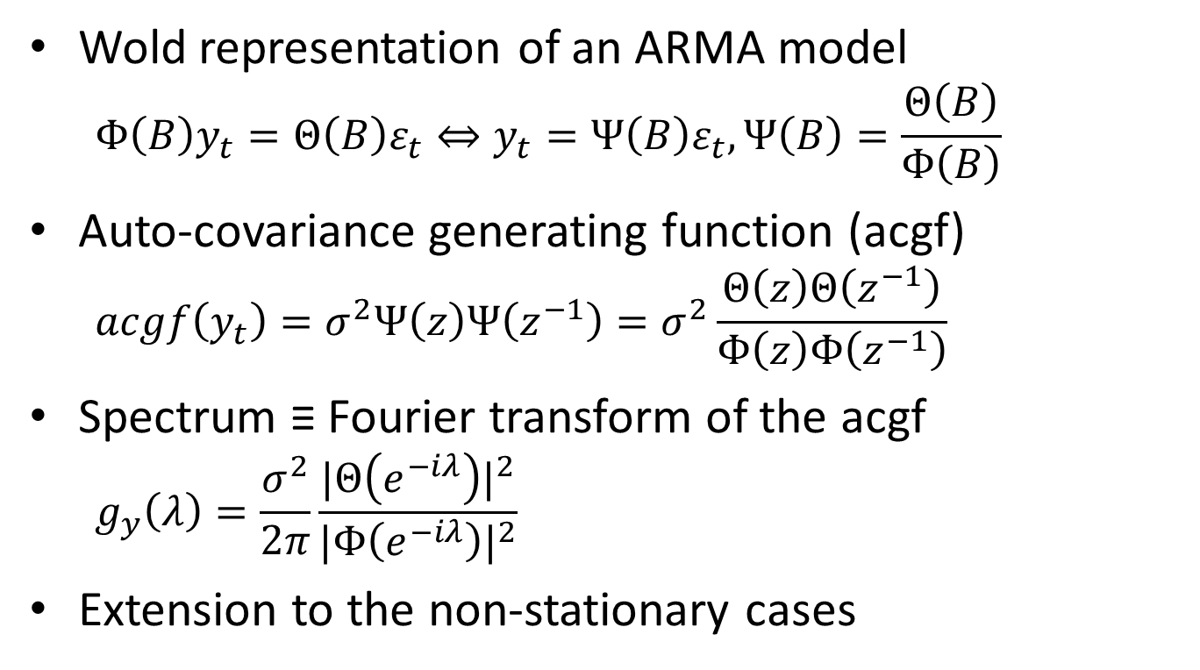
0.2 Useful tools
Wold representation of an ARMA model
$$Φ\left(B\right)y_{t}=Θ\left(B\right)ε_{t}⇔y_{t}=Ψ\left(B\right)ε_{t},Ψ\left(B\right)=\frac{Θ\left(B\right)}{Φ\left(B\right)}$$
Auto-covariance generating function (acgf)
$$acgf\left(y_{t}\right)=σ^{2}Ψ\left(z\right)Ψ\left(z^{−1}\right)=σ^{2}\frac{Θ\left(z\right)Θ\left(z^{−1}\right)}{Φ\left(z\right)Φ\left(z^{−1}\right)}$$
Spectrum ≡ Fourier transform of the acgf
$$g_{y}\left(λ\right)=\frac{σ^{2}}{2π}\frac{{|Θ\left(e^{−iλ}\right)|}^{2}}{{|Φ\left(e^{−iλ}\right)|}^{2}}$$
Extension to the non-stationary cases

Slide 6
1. Unobserved components model
Principle
The different components of the series are “defined” by [ARIMA] models
The components are independent
The sum of the model of the components is the model of the series

Slide 7





1.1 Unobserved components model (STS)
Theoretical model
Series($θ_{T,S,I})$
Trend($θ_{T})$
Seasonal($θ_{S})$
Irregular($θ_{I})$
<=
+
+
Independent
$${\hat{θ}}_{T,S,I}$$
Observed time series

Slide 8
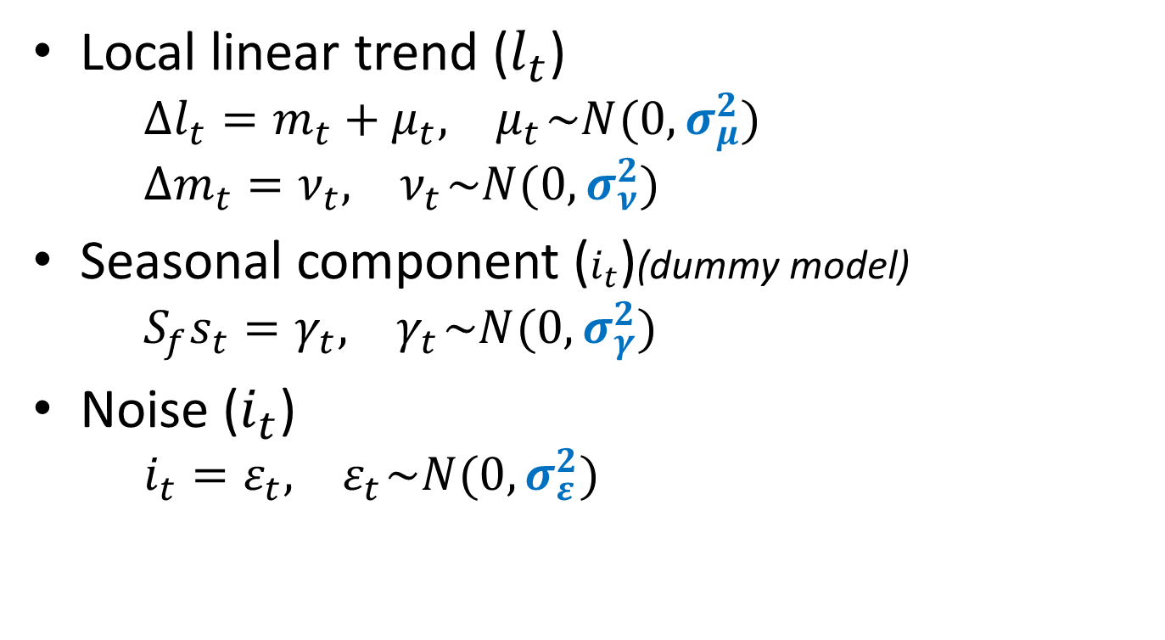
1.1.1 Basic structural model (STS)
Local linear trend ($l_{t}$)
$$∆l_{t}=m_{t}+μ_{t},{ μ}_{t}\sim N(0, σ_{μ}^{2})$$
$$∆m_{t}=ν_{t},{ ν}_{t}\sim N(0, σ_{ν}^{2})$$
Seasonal component ($i_{t}$)(dummy model)
$$S_{f}s_{t}=γ_{t},{ γ}_{t}\sim N(0, σ_{γ}^{2})$$
Noise ($i_{t}$)
$$i_{t}=ε_{t},{ ε}_{t}\sim N(0, σ_{ε}^{2})$$

Slide 9





1.2 Unobserved components model (AMB)
Theoretical model
Series($θ_{Y})$
Trend($θ_{Y})$
Seasonal($θ_{Y})$
Irregular($θ_{Y})$
=>
+
+
Independent
$${\hat{θ}}_{Y}$$
Observed time series

Slide 10

1.2.1 Airline model
$ΔΔ_{f}y_{t}=Θ(B)$ $Θ\left(B^{f}\right)$ $ε_{t},{ ε}_{t}\sim N\left(0, σ_{ε}^{2}\right)$
Or
$$y_{t}={y_{t−f}+(y}_{t−1}−y_{t−f−1})+$$
$$ε_{t}+θ_{f}ε_{t−f}+θ(ε_{t−1}+θ_{f}ε_{t−f−1}),$$
$${ ε}_{t}\sim N\left(0, σ_{ε}^{2}\right)$$

Slide 11
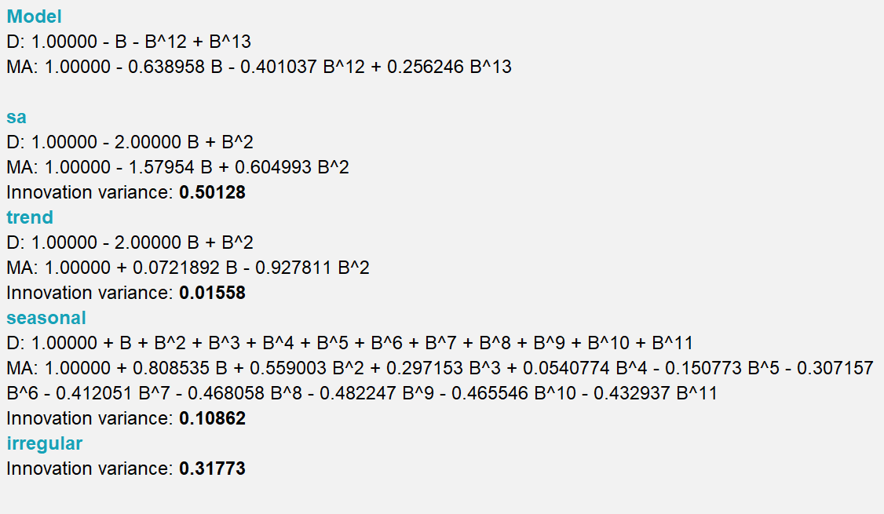
1.2.2 Airline decomposition

Slide 12
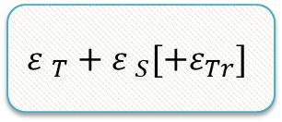

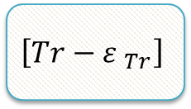



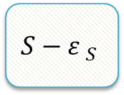
2. SEATS algorithm
Factorization based on the auto-regressive part (AR and I)
ARIMA
$$T$$
$$S$$
$\left[Tr\right]$
See:
Gomez and Maravall…
Canonical decomposition
$$T−{ε }_{T}$$
$$S−{ε }_{S}$$
$$\left[Tr−{ε }_{Tr}\right]$$
$${ε }_{T}+{ε }_{S}[+ε_{Tr}]$$

Slide 13
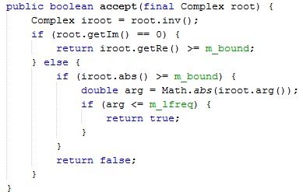
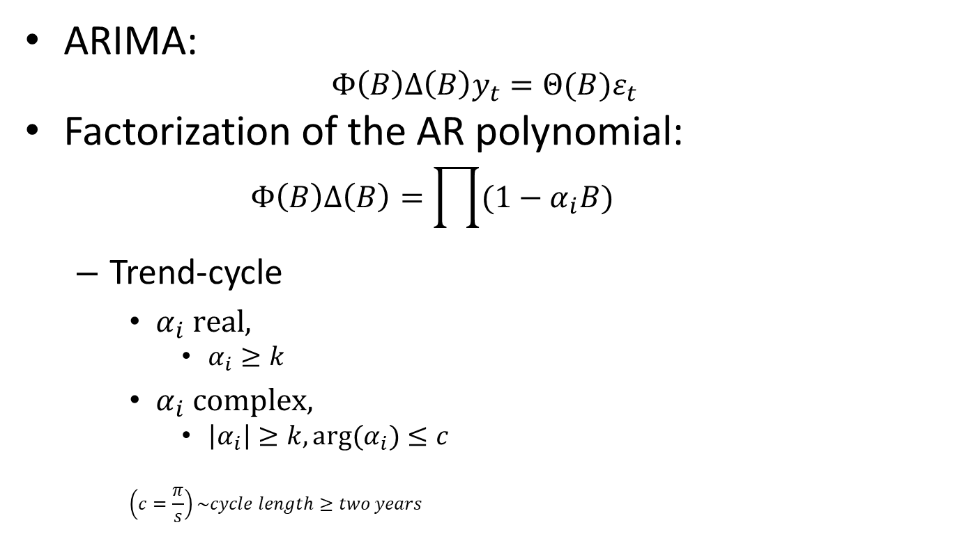
2.1 SEATS Algorithm. Details (I)
ARIMA:
$$Φ\left(B\right)Δ\left(B\right)y_{t}=Θ(B)ε_{t}$$
Factorization of the AR polynomial:
$$Φ\left(B\right)Δ\left(B\right)=\prod{(1−α_{i}B)}$$
Trend-cycle
$α_{i} real,$
$α_{i}≥k$
$α_{i} complex,$
$\left|α_{i}\right|≥k, arg(α_{i})≤c$
$$\left(c=\frac{π}{s}\right)\sim cycle length≥two years$$
TrendCycleSelector.java

Slide 14
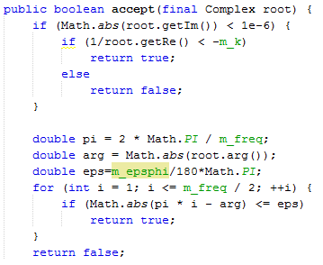

Seasonal
$α_{i} real,$
$α_{i}<−l$
$α_{i} complex,$
$\left|arg\left(α_{i}\right)−f_{s}\right|≤e$
$$f_{s} seasonal frequency$$
Transitory (I)
All other roots
SeasonalSelector.java
Trend boundary | k
Seasonal tolerance (degree) | e
Seasonal boundary | l
Seas.boundary (unique) | l (no seasonal part)

Slide 15
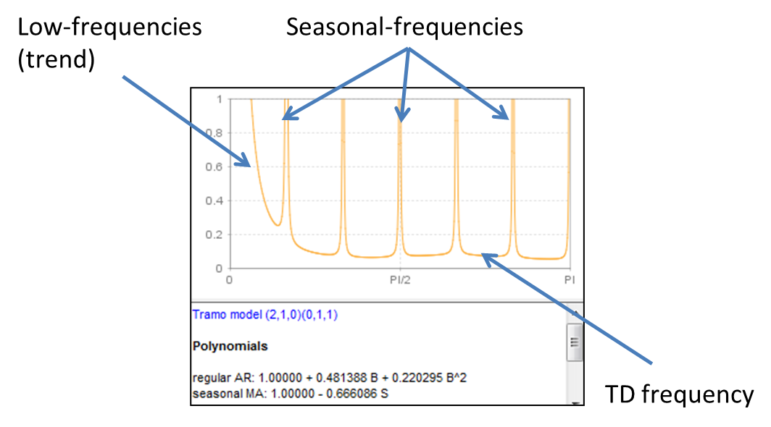
2.2 SEATS spectral decomposition
Splitting of the spectrum following the different « types » of frequencies

Slide 16
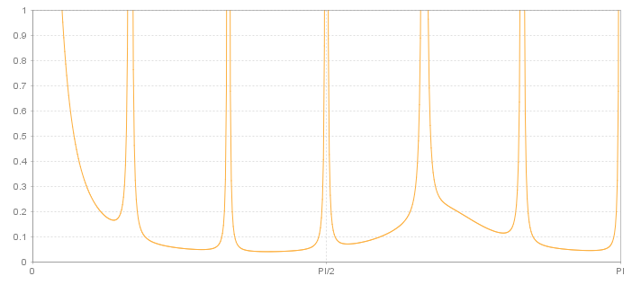
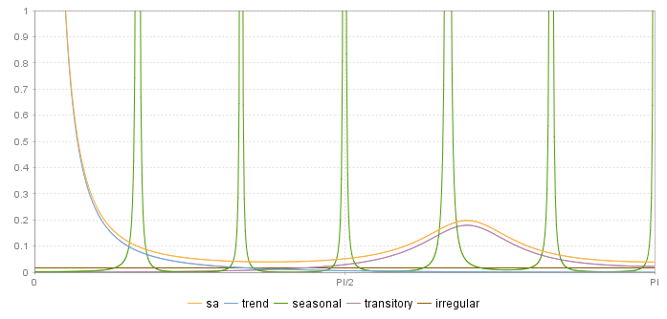


2.2 SEATS spectral decomposition
$$S_{Y}=S_{T}+S_{S}+S_{Tr}+S_{I}$$
$$S_{SA}=S_{T}+S_{Tr}+S_{I}=S_{Y}−S_{S}$$
Independent components !

Slide 17
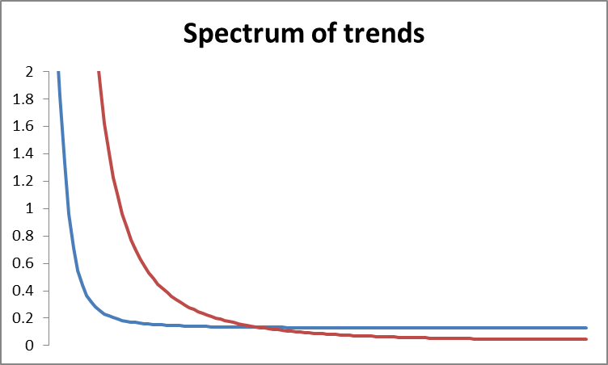
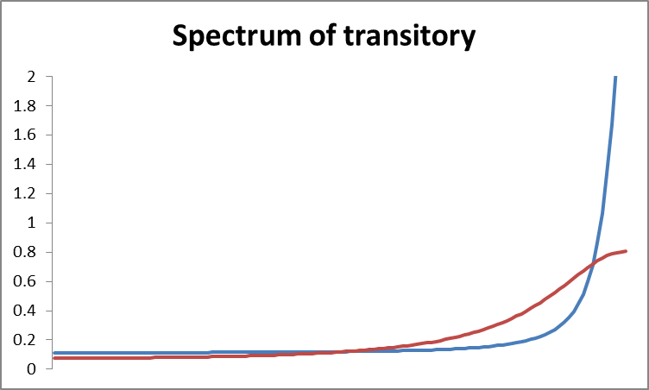
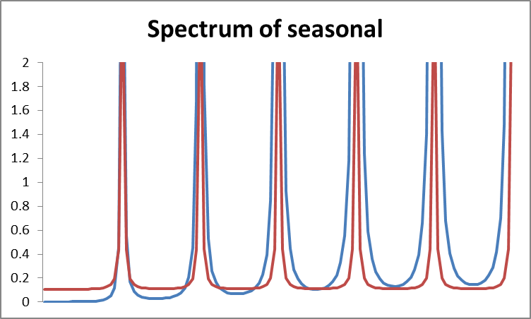
2.2 SEATS spectral decomposition
Smoother trend
Switchback pattern
More stable seasonal

Slide 18
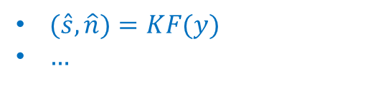
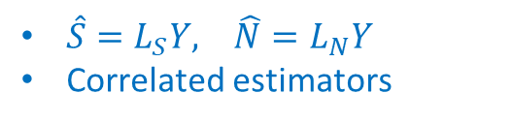
3. Estimation of the model
Independant components
Sum of cmps <=> y
Components model
Estimators = Linear transformations of y
MMSE criterion
Components estimators
$\hat{S}=L_{S}Y, \hat{N}=L_{N}Y$
Correlated estimators
Estimation by means of KF, Burman’s, McElroy’s algorithms…
Components estimates
$(\hat{s},\hat{n})=KF(y)$
$…$

Slide 19
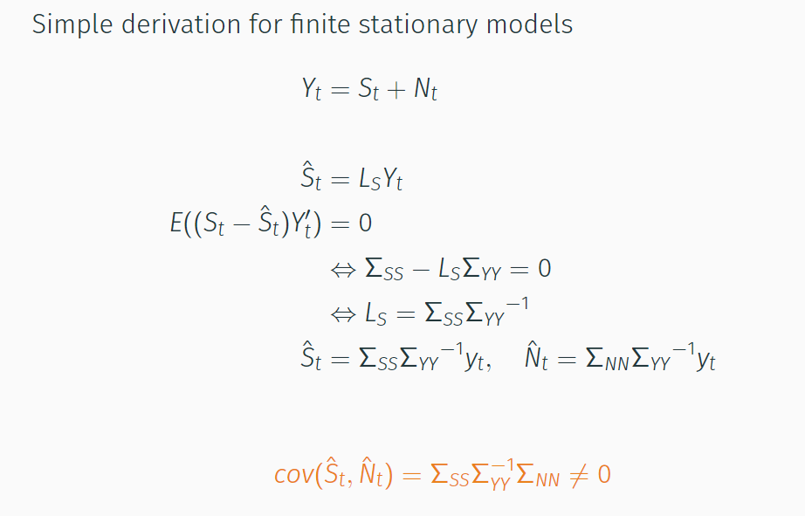
3.1 Basic case

Slide 20
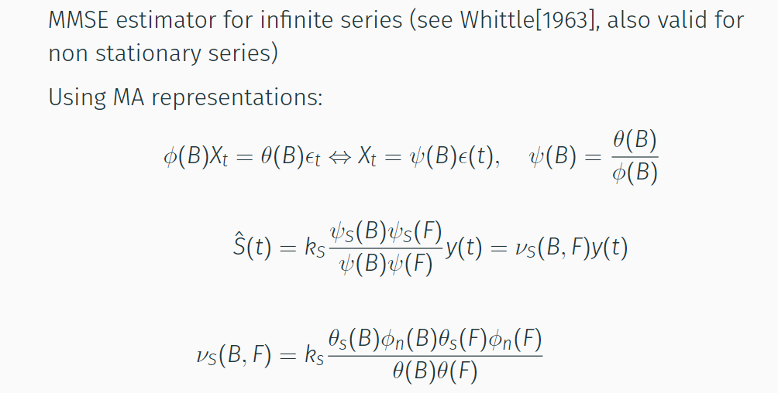
3.2 Wiener-Kolmogorov filters

Slide 21
3.3 Estimation of the components
STS and AMB → UCARIMA models
Same estimation algorithms
Common analysis tools
3 solutions, strictly equivalent (except for SD)
Burman algorithm (WK filters): legacy and default solution, fastest
Kalman smoother: more stable, exact SD
[Matrix computation]: Not available in JD+ 3.x

Slide 22
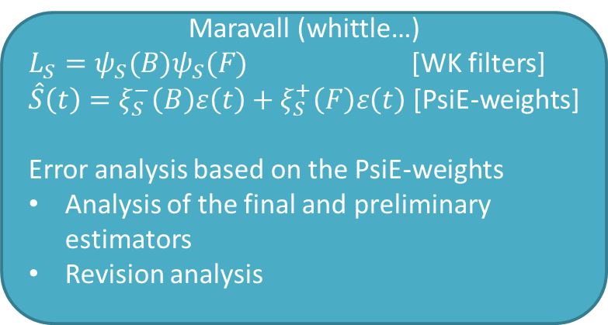
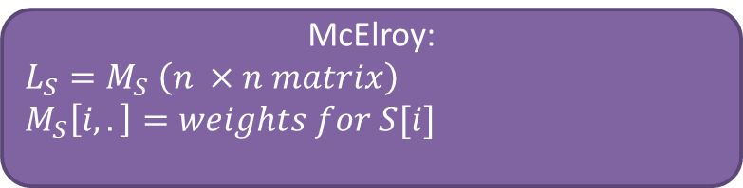
4. Analysis
McElroy:
$$L_{S}=M_{S} \left(n ×n matrix\right)$$
$$M_{S}\left[i,.\right]=weights for S[i]$$
Components estimators
Maravall (whittle…)
$L_{S}=ψ_{S}(B)ψ_{S}(F)$ [WK filters]
$\hat{S}\left(t\right)=ξ_{S}^{−}\left(B\right)ε\left(t\right)+ξ_{S}^{+}\left(F\right)ε\left(t\right)$ [PsiE-weights]
Error analysis based on the PsiE-weights
Analysis of the final and preliminary estimators
Revision analysis

Slide 23
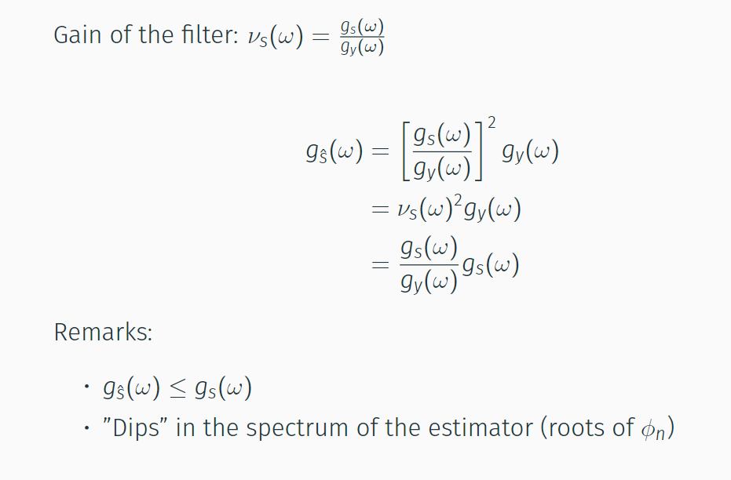
4.1 Analysis in the frequency domain

Slide 24
4.1 Analysis in the frequency domain
(Squared-) gain of the filters:
What are the frequencies that are kept/removed by the filter
The estimators “underestimate” the variance of the components
Similar analysis for the preliminary estimators
Non-symmetric filters → phase effects

Slide 25
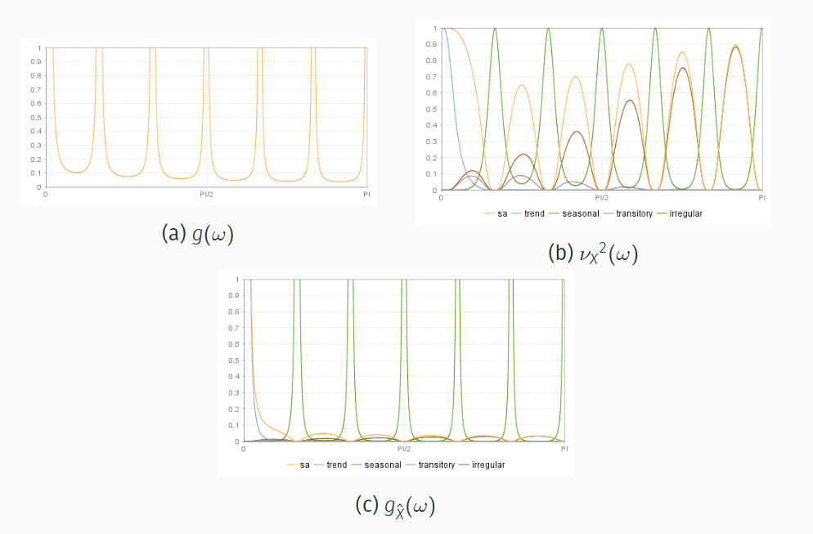
4.2 Graphical representations

Slide 26
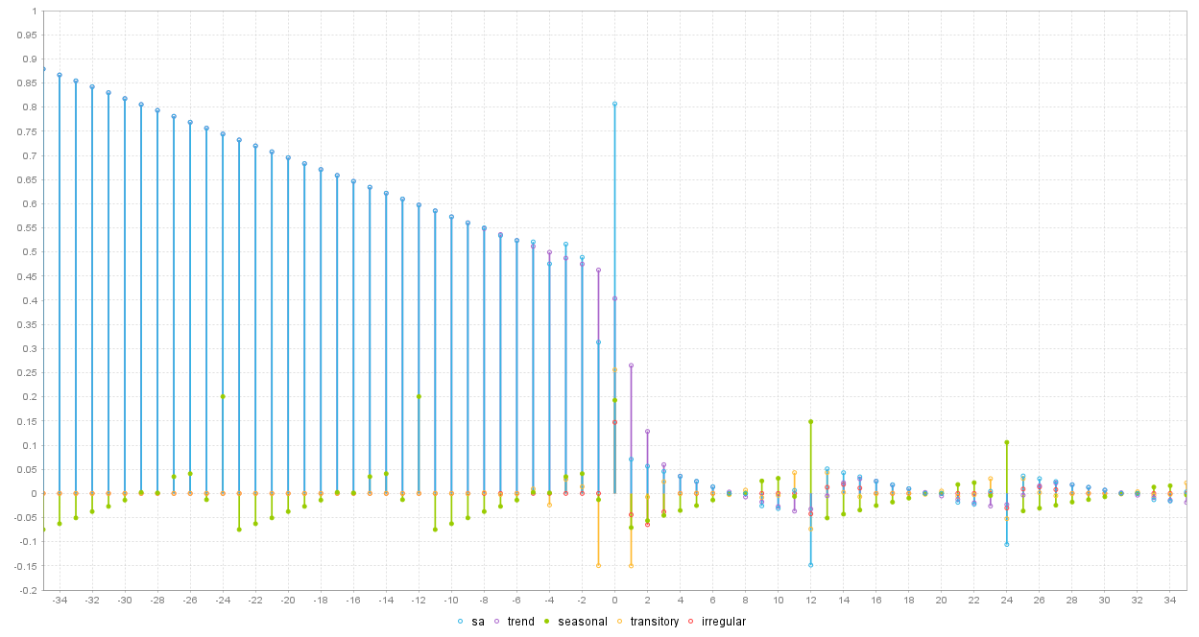
4.2 PsiE-weights
=Psi weights for estimators

Slide 27
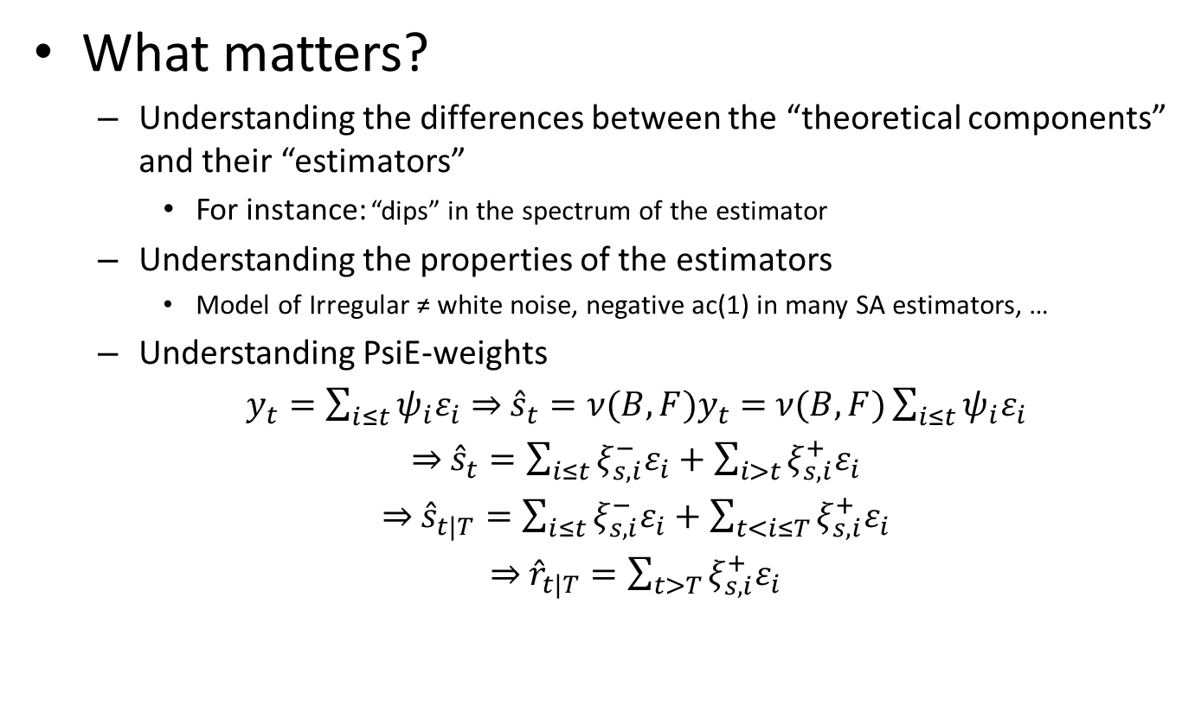
4.3 Analysis
What matters?
Understanding the differences between the “theoretical components” and their “estimators”
For instance: “dips” in the spectrum of the estimator
Understanding the properties of the estimators
Model of Irregular ≠ white noise, negative ac(1) in many SA estimators, …
Understanding PsiE-weights
$y_{t}=\sum_{i≤t}{ψ_{i}ε_{i}}⇒$ ${\hat{s}}_{t}=ν(B,F)y_{t}=$ $ν(B,F)\sum_{i≤t}{ψ_{i}ε_{i}}$
$⇒$ ${\hat{s}}_{t}=\sum_{i≤t}{ξ_{s,i}^{−}ε_{i}}+\sum_{i>t}{ξ_{s,i}^{+}ε_{i}}$
$⇒$ ${\hat{s}}_{t|T}=\sum_{i≤t}{ξ_{s,i}^{−}ε_{i}}+\sum_{t<i≤T}{ξ_{s,i}^{+}ε_{i}}$
$⇒$ ${\hat{r}}_{t|T}=\sum_{t>T}{ξ_{s,i}^{+}ε_{i}}$

Slide 28
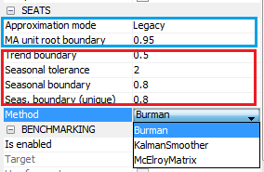
5. SEATS in JD+
Modification of the model
Decomposition of the model
Estimation of the components

Slide 29
5.1 SEATS in JD+ (cont.)
Impact of the parameters
Only in case of AR polynomials
k
Small: possible « noisy » trend
k ≈ 1: more stable trend
e
Large (>5): possible short term cycle in the seasonal (for instance, stochastic TD)→erratic seasonal
l
Small (<.8): higher risk of erratic seasonal
General consideration: threshold effects are unavoidable

Slide 30
5.2 Non decomposable models
Some models are not decomposable (often due to complex models)
Best solution: change yourself the model (→airline)
Otherwise:
Legacy: Seats search for another SARIMA model, as similar as possible to the original model
Noisy: Seats add noise in the initial model (→ I = Tr[= 0])

Slide 31
6. Final remarks
What matters?
Impact of the model on
SA/S “smoothness” ⇒ Be very careful with stationary AR roots
Revisions
Use PsiE-weights to understand/anticipate revisions
Model-based diagnostics
Variance estimators<> variance estimates
Should not happen if the original model is well defined
Be careful with non decomposable models / fixed models / “bad” models
To go further, see:
“SEASONAL ADJUSTMENT AND SIGNAL EXTRACTION IN ECONOMIC TIME SERIES”, by R. Gomez and A. Maravall

Slide 32
6. Final remarks (cont.)
Advantages and drawbacks of model-based decomposition
+
« Optimal filters », tailored for each series
Many useful additional information (uncertainty…)
-
Might generate huge revisions
Some recommendations
Fix the model
Fix the series in the past (5 year revisions)
Fix the parameters and revise them when you revise the raw data
Be pragmatic !

